Slide 1

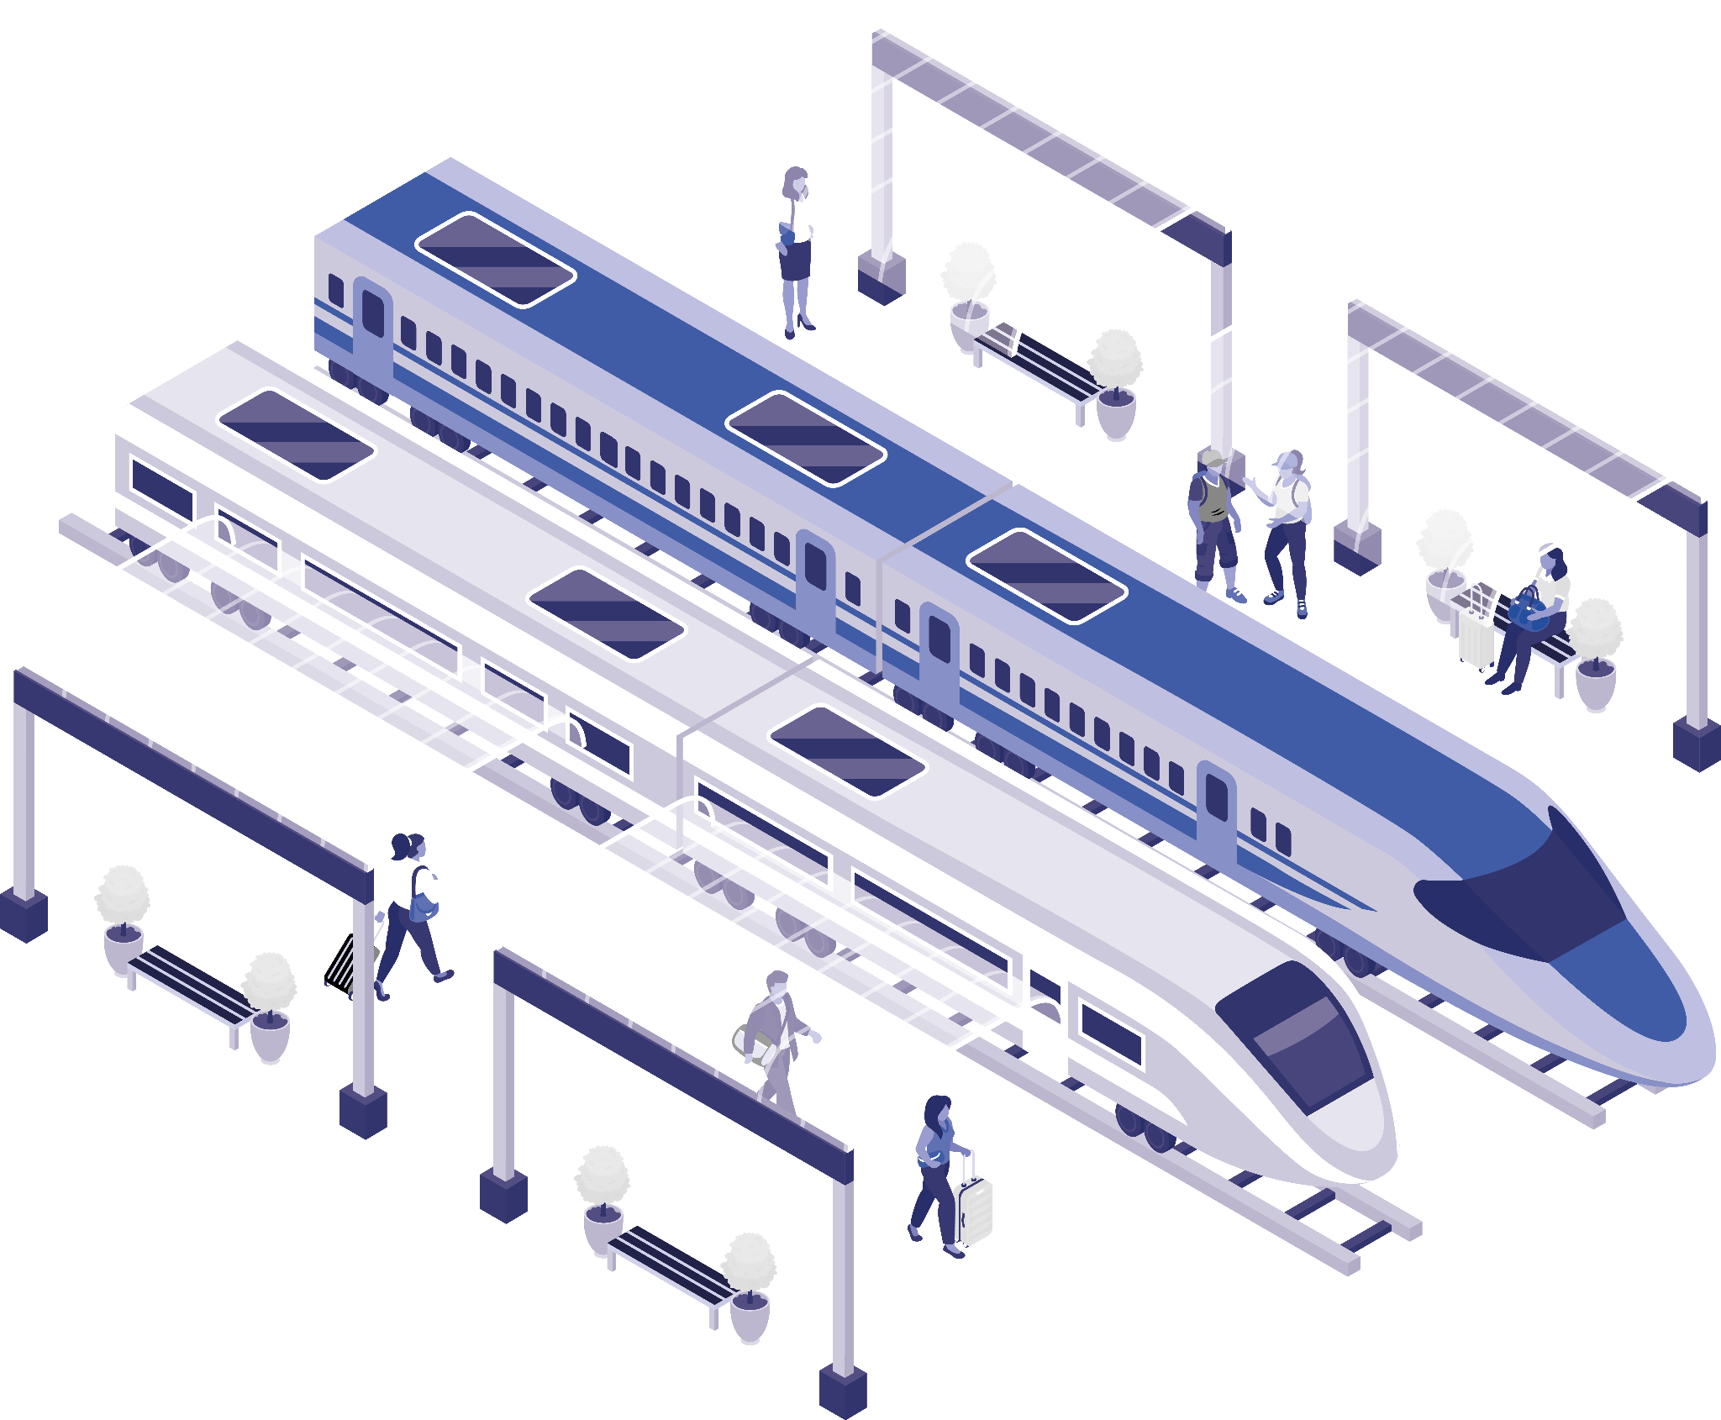
Railway Reservation System
NAME:

Slide 2
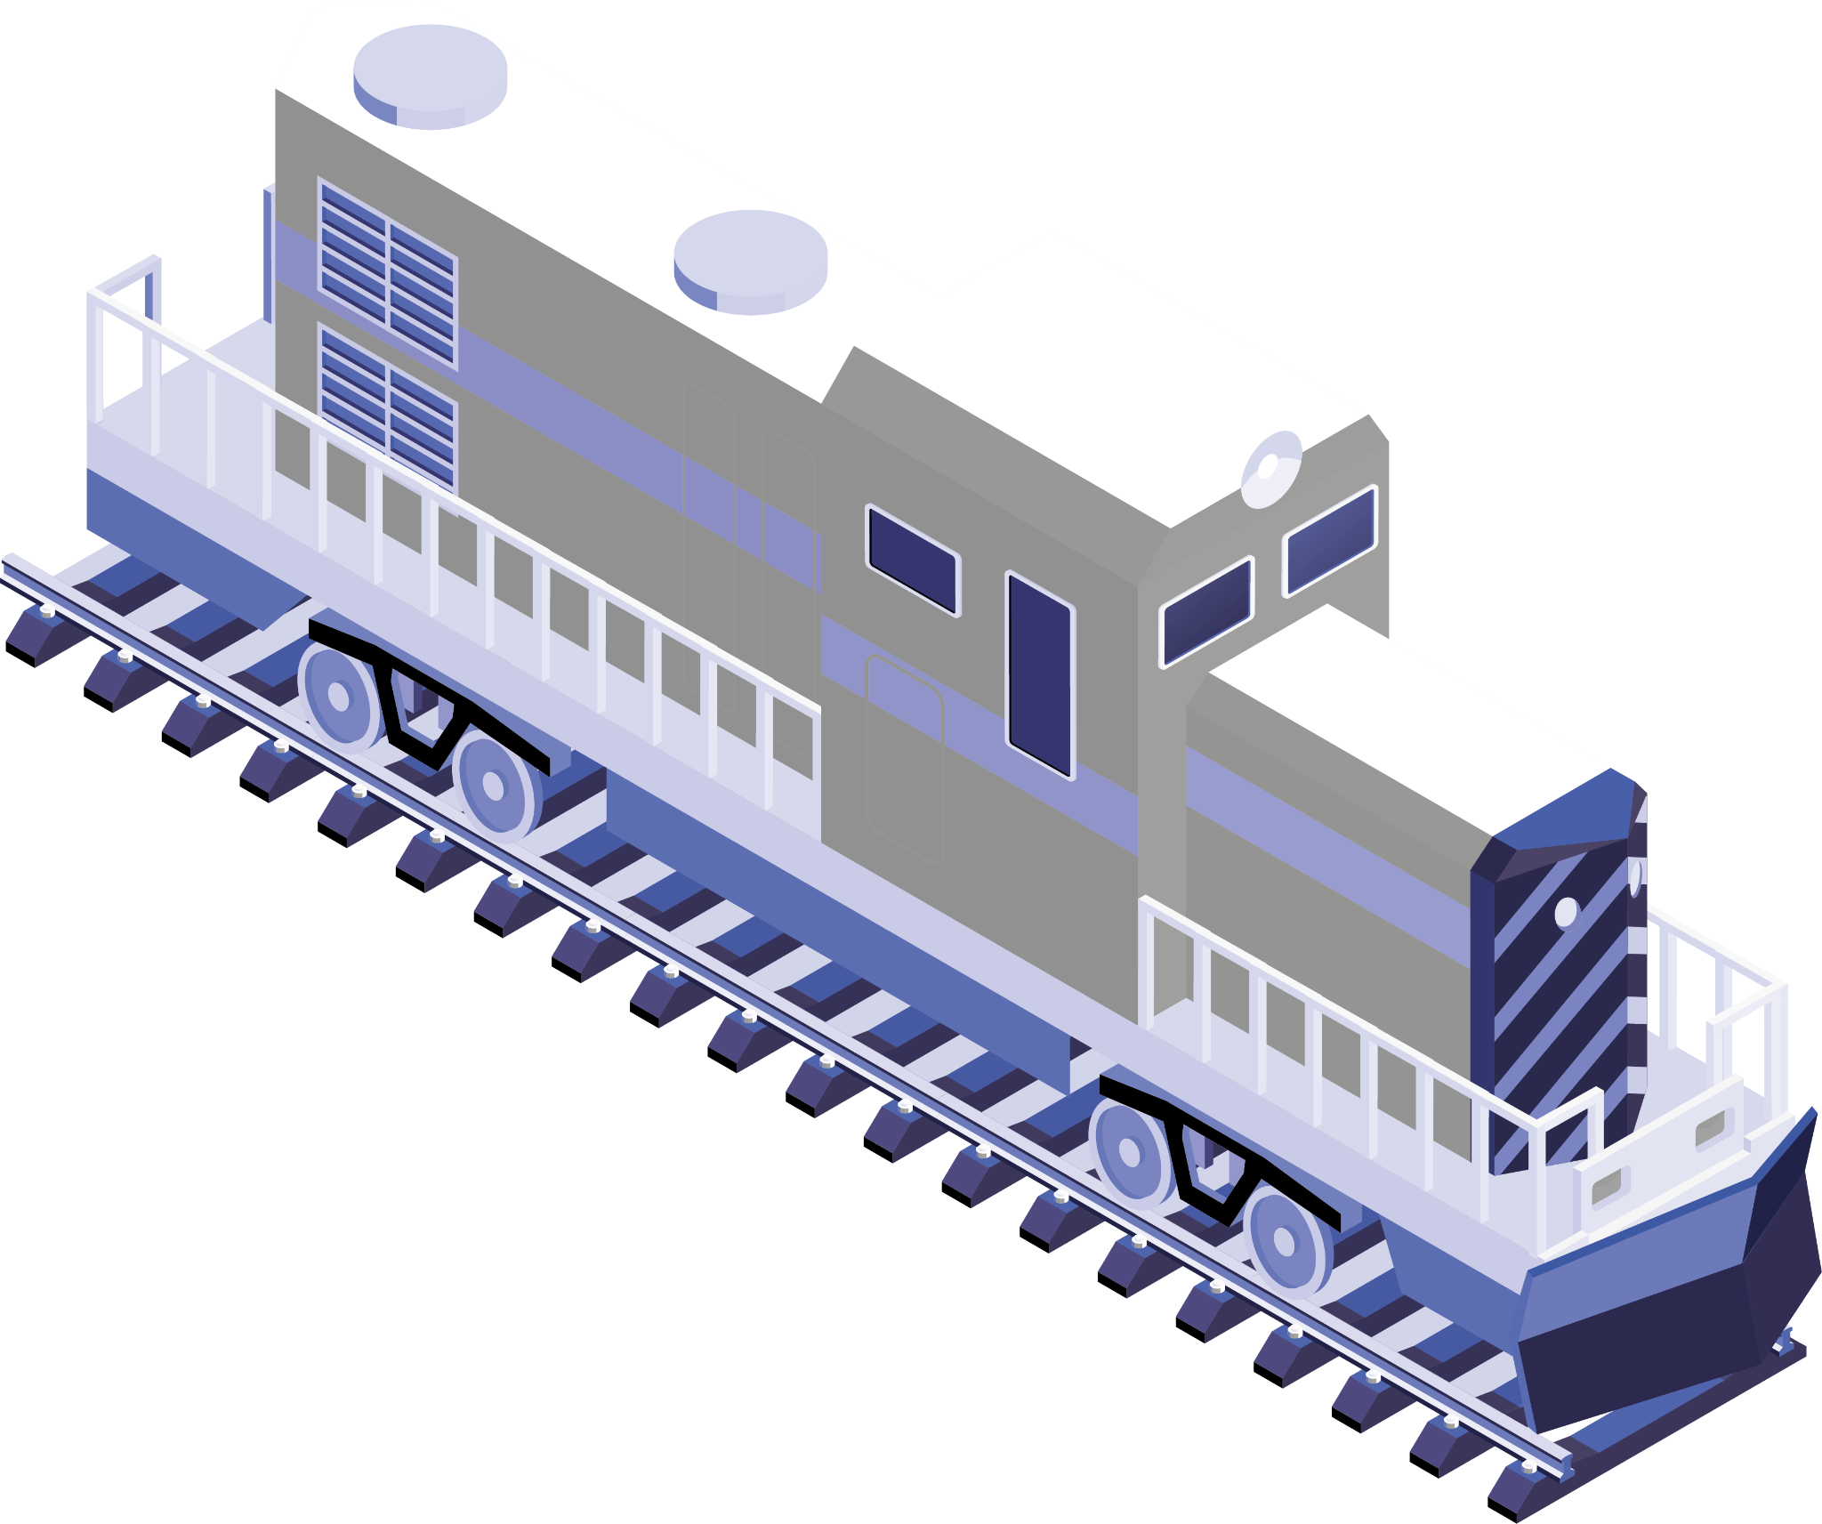
Introduction
Welcome to our presentation on the Railway Reservation System, a transformative solution for streamlining the ticket booking experience in the railway industry.
In today's fast-paced world, travelers demand efficiency, convenience, and security when booking their train tickets.
The Railway Reservation System addresses these demands by leveraging technology to revolutionize how passengers reserve their seats and plan their journeys.

Slide 3

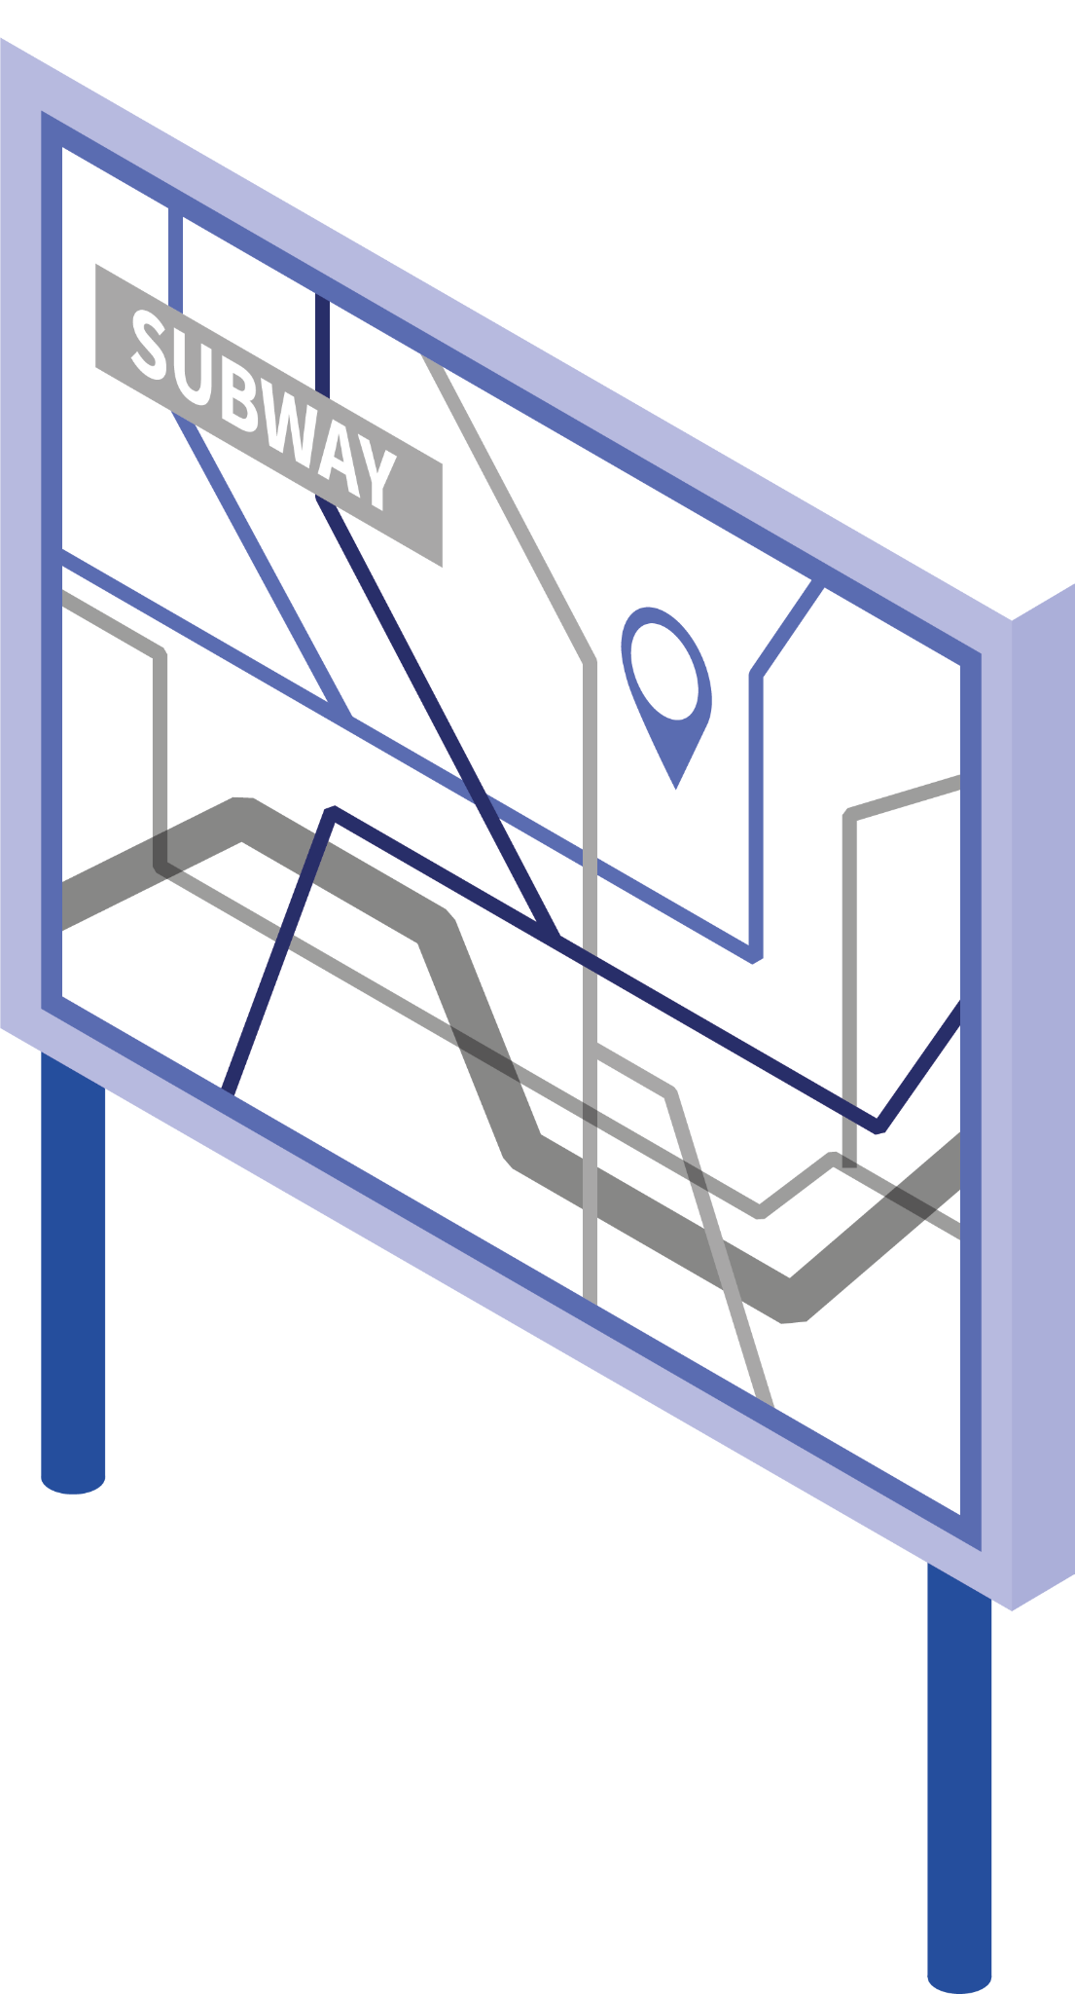
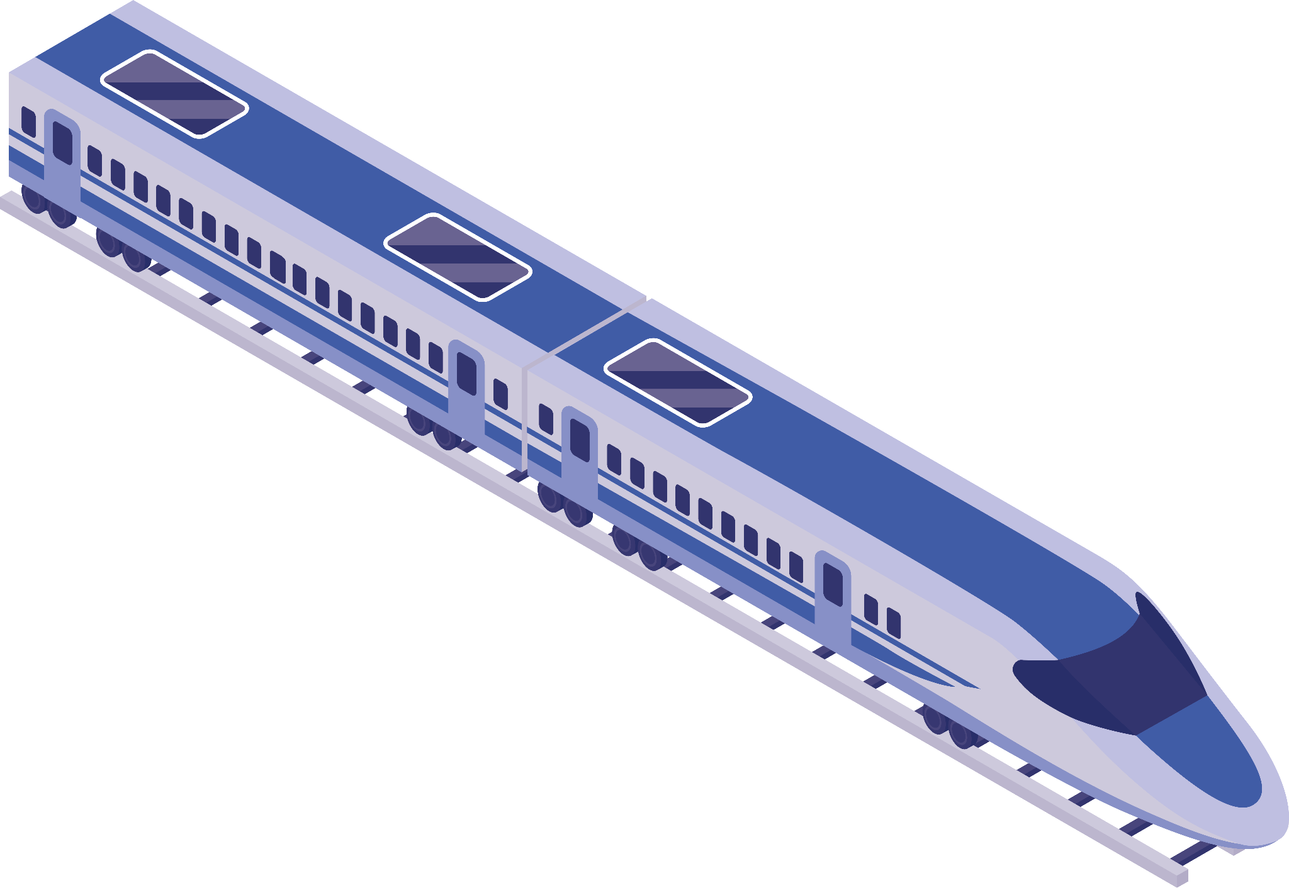
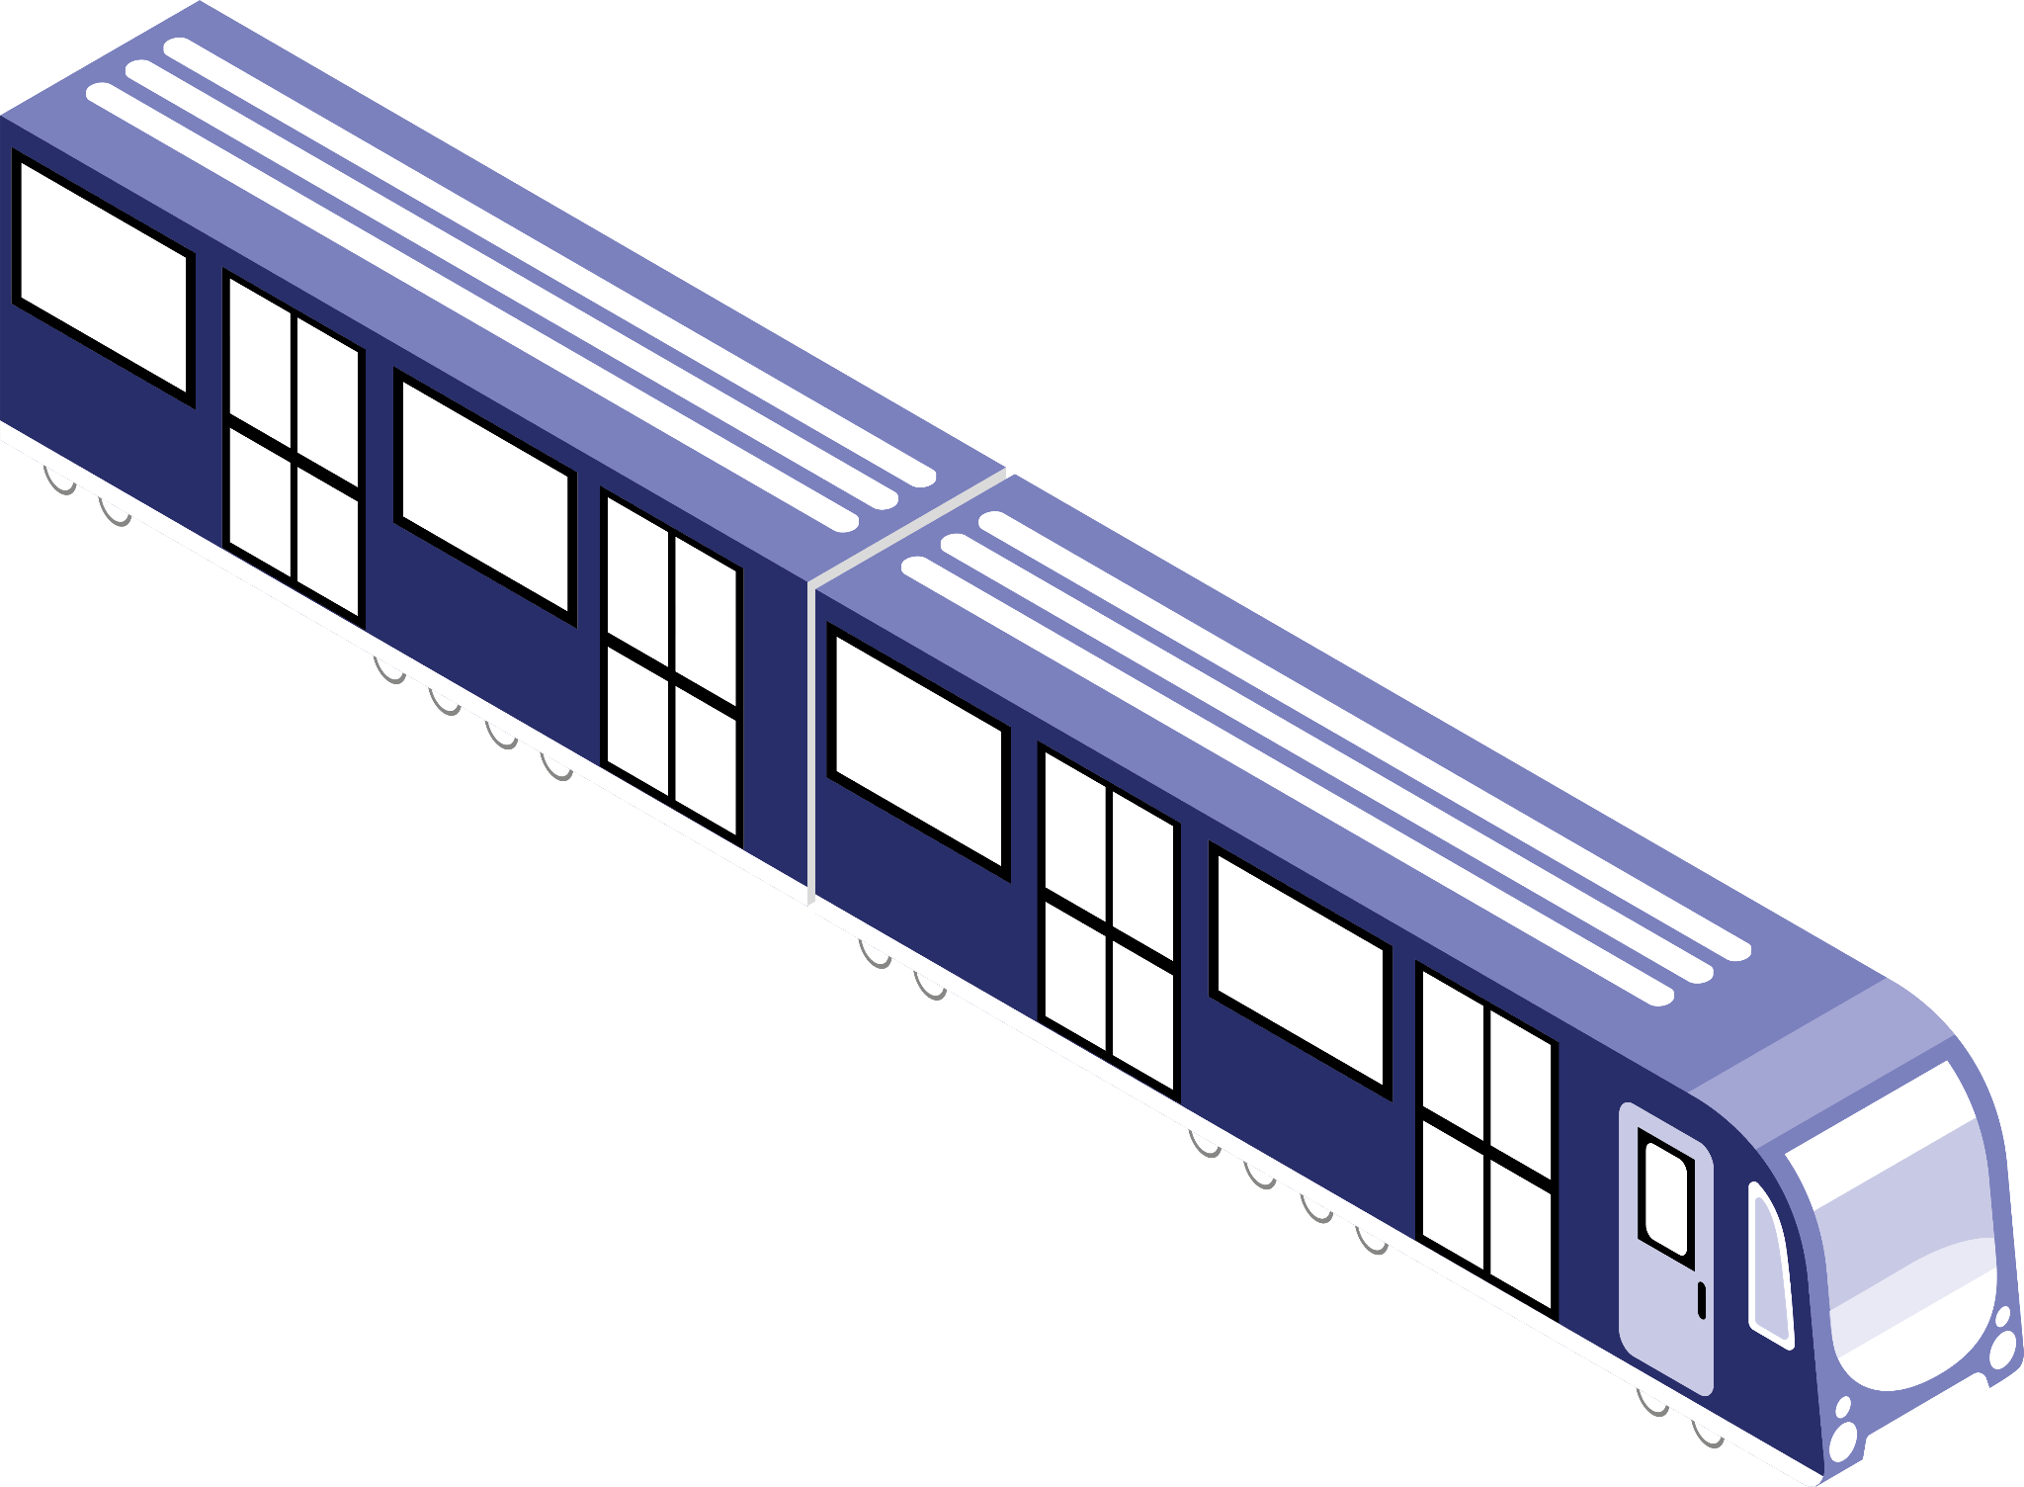
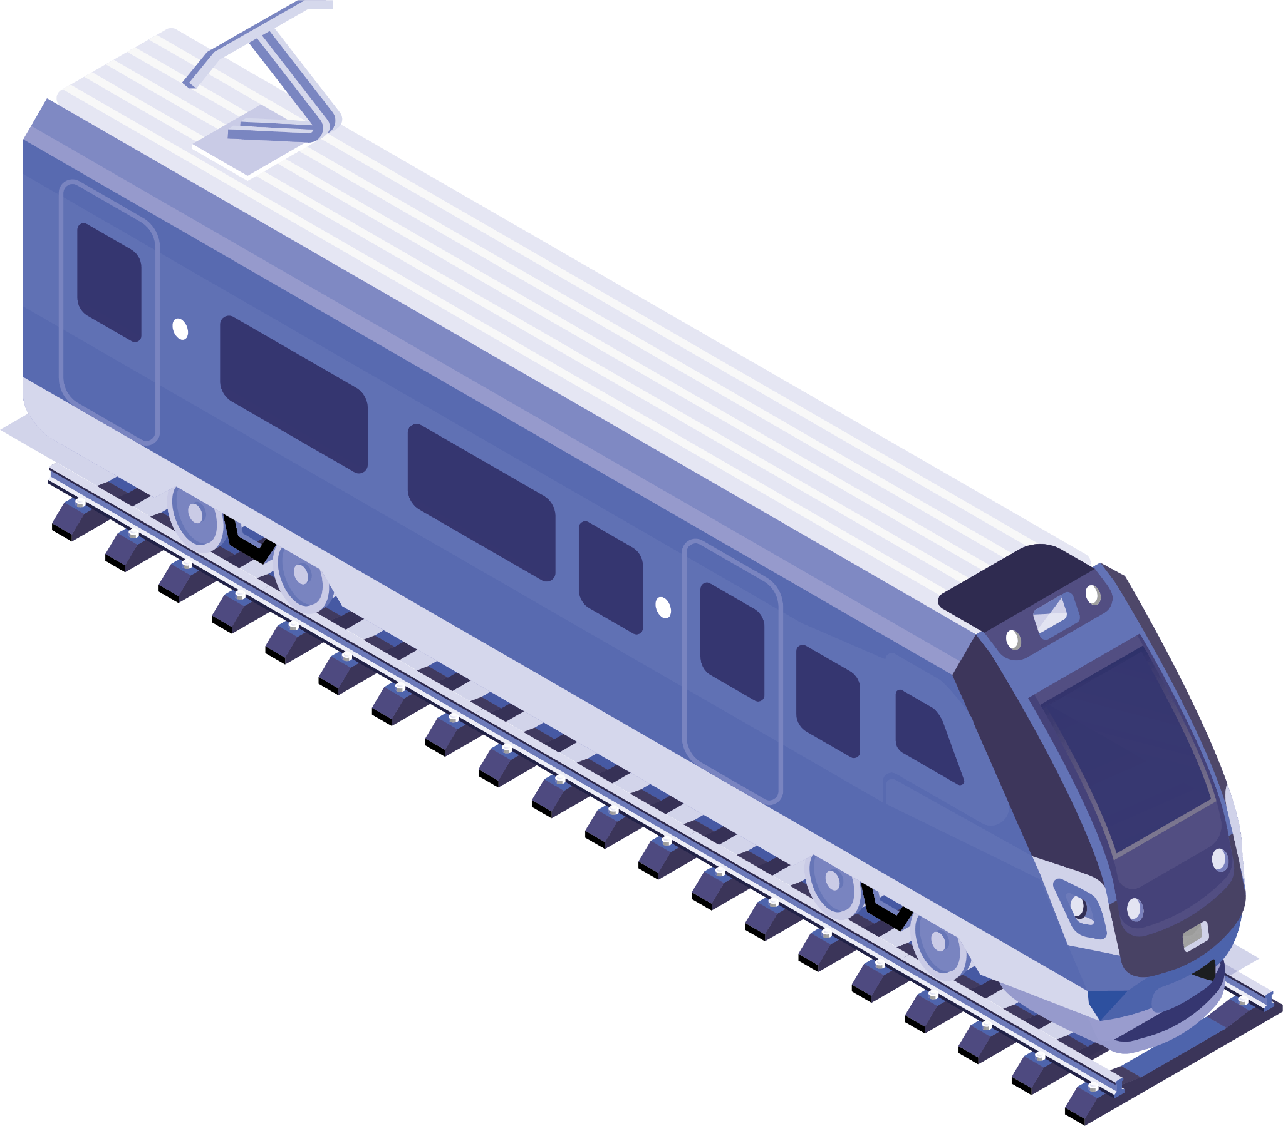
Concepts Use
2.FileReader
3.FileWriter
1.JDBC
4.
6.
5.

Slide 4
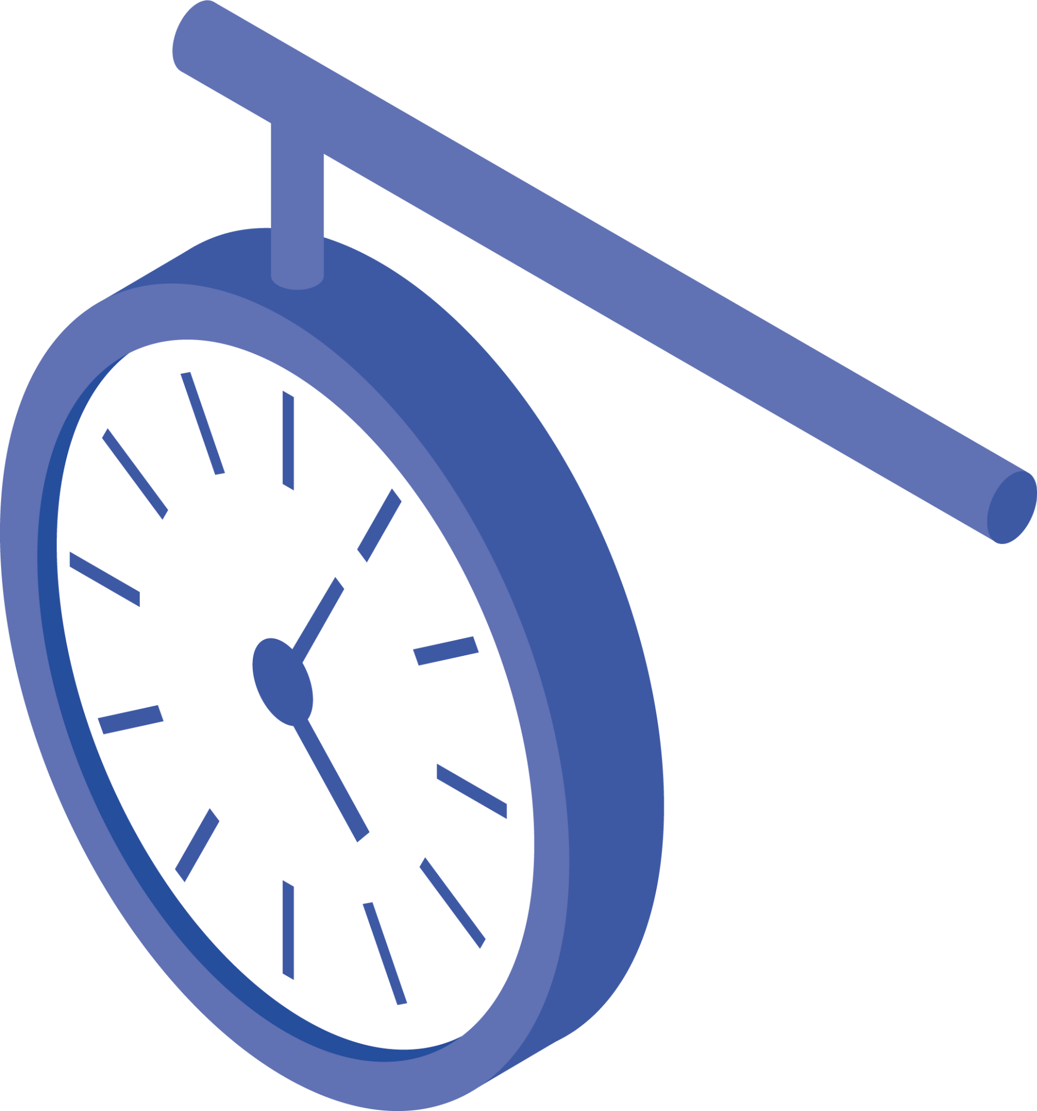
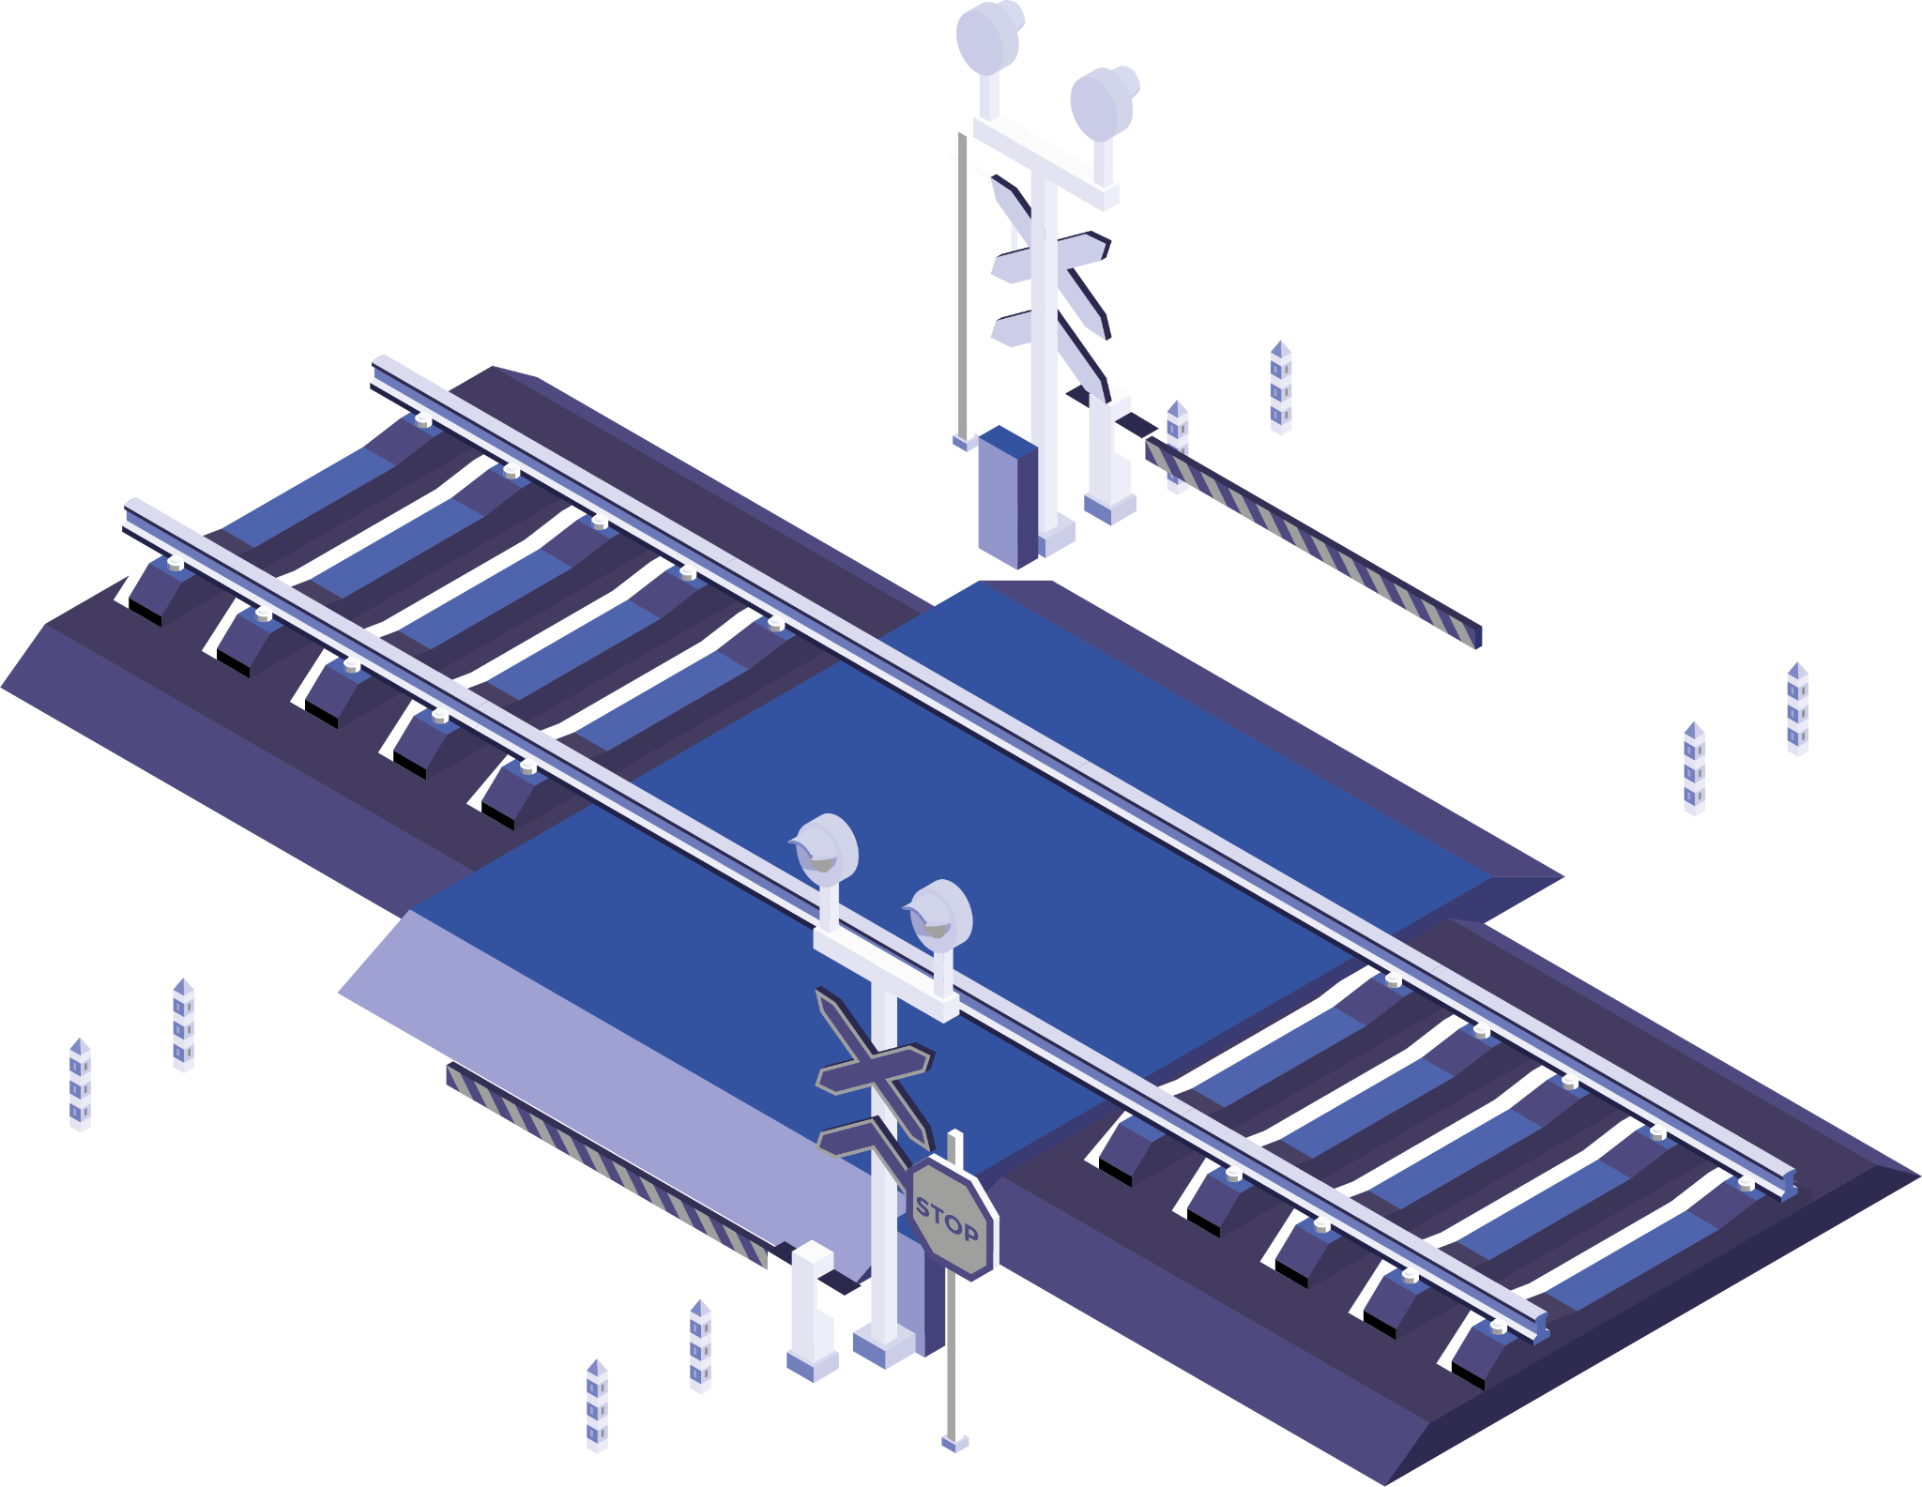
Methods
1
2
View Trains
Book Train

Slide 5
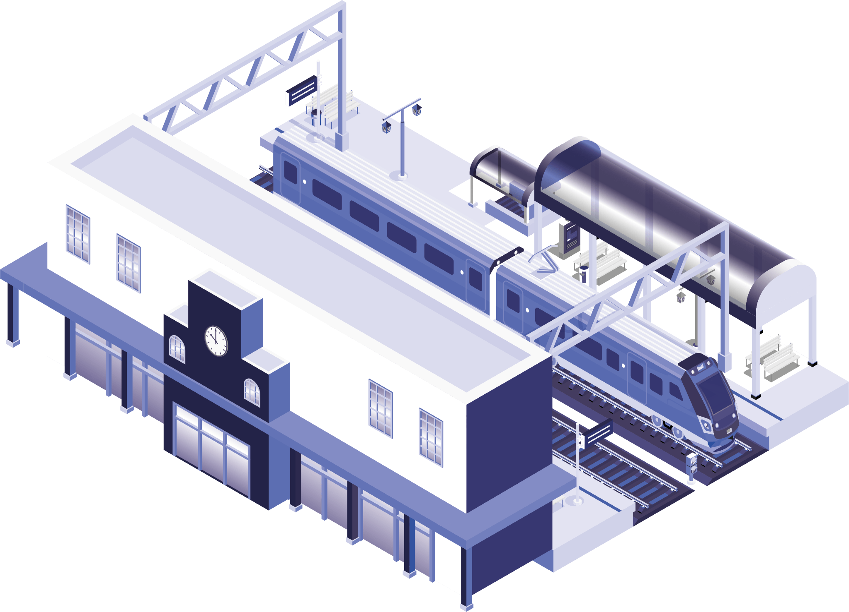
1
View Trains
In View Trains select starting and Ending destination from Database using JDBC.

Slide 6
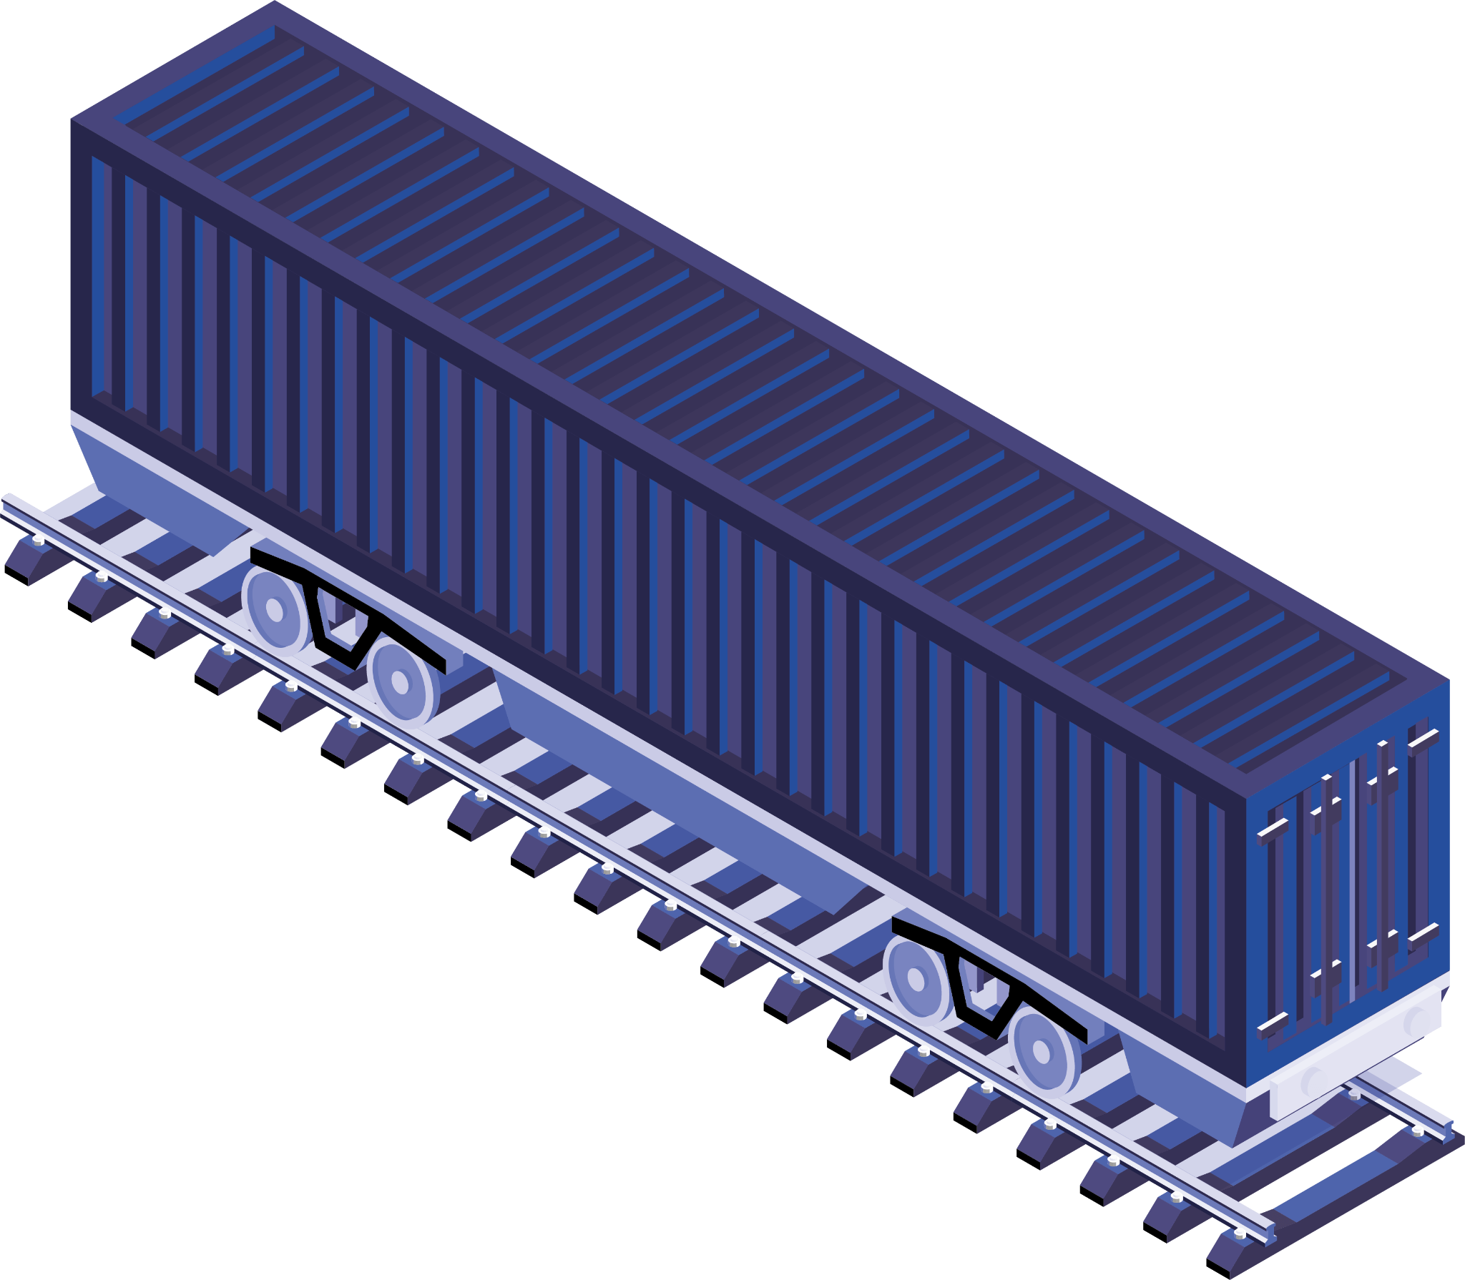
2
Book Train
For Book Train First Register Your Self
Then Select destination ,Train ,date ,Seat ,Food

Slide 7
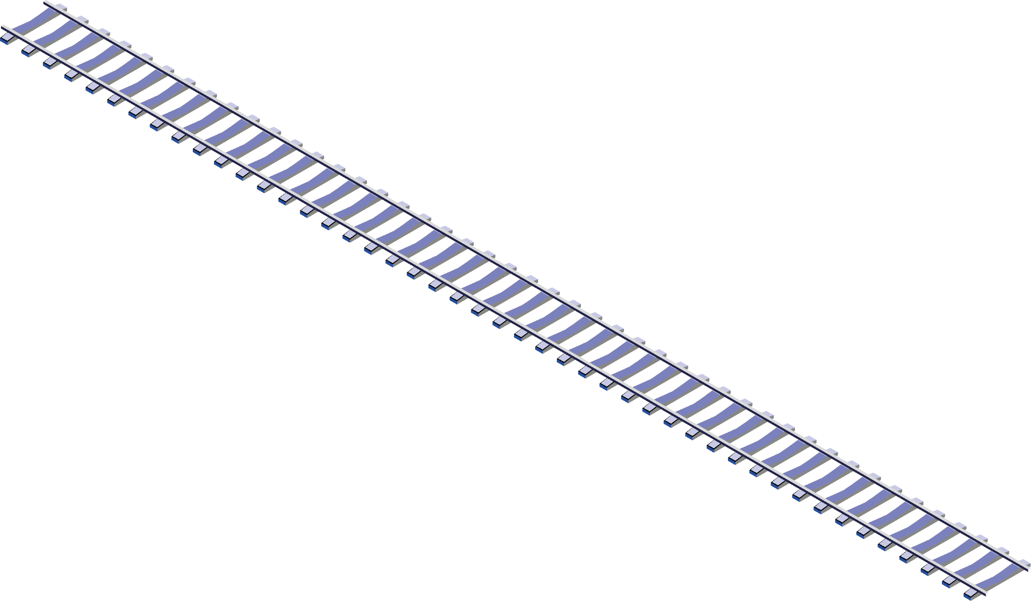
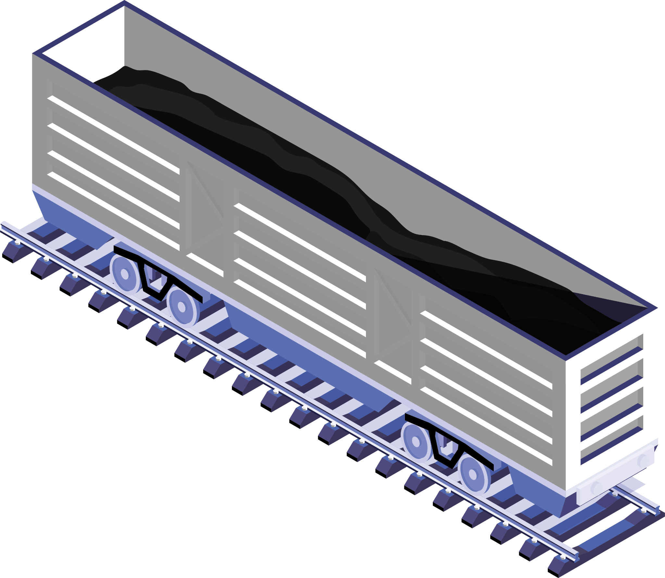
How Methods Work?
1
Ticket Booking Process
User
Registration
2
3
Passenger Information
Seat Allocation
4

Slide 8
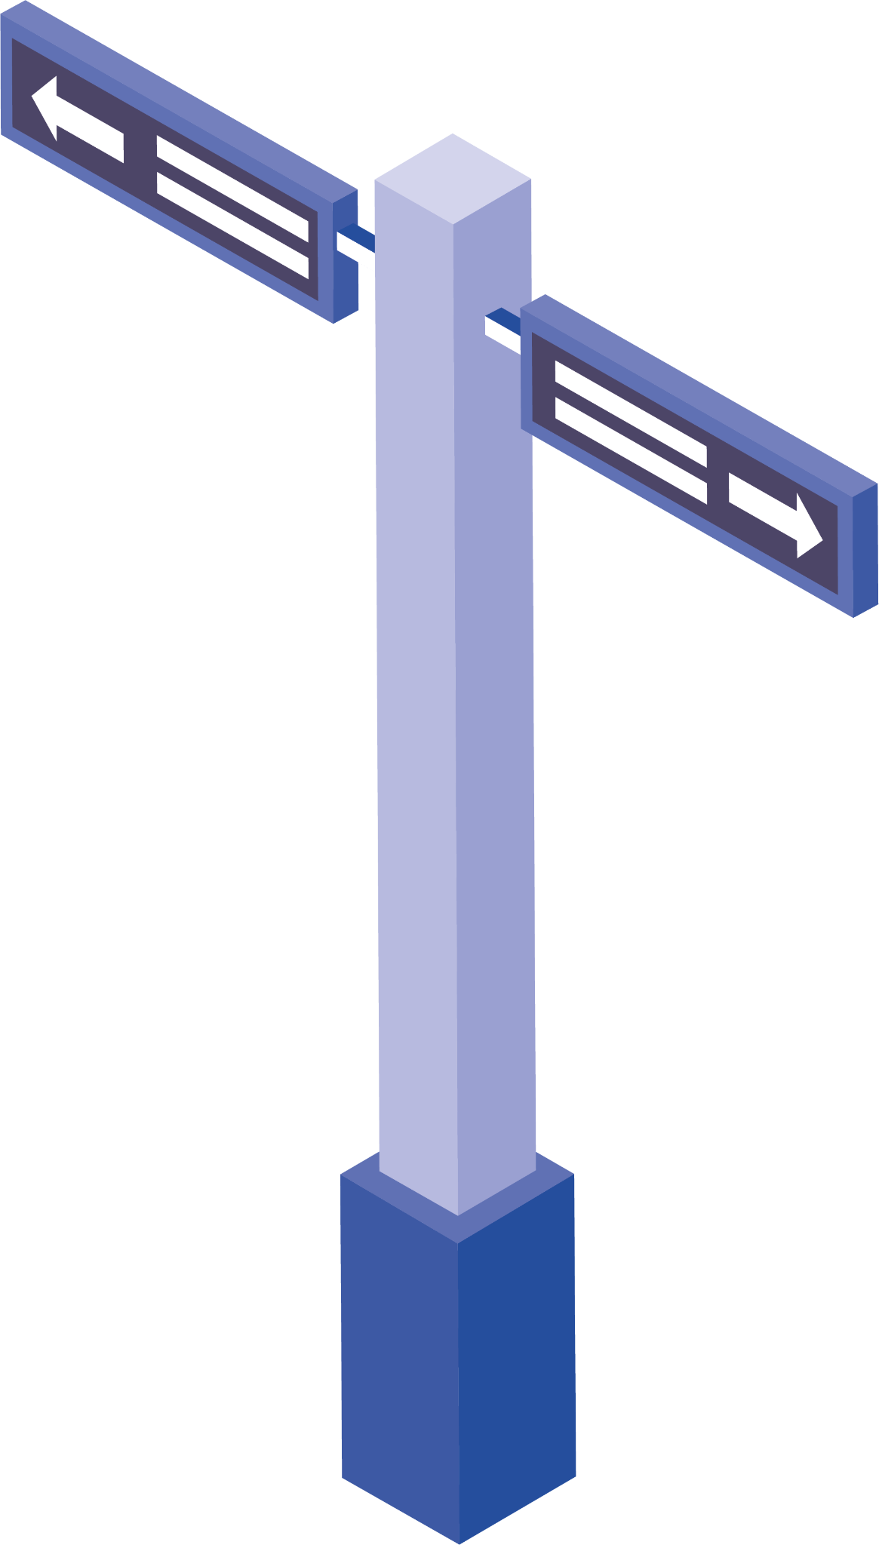

Objectives
The Railway Reservation System is designed with several key objectives in mind. These objectives are aimed at enhancing the rail travel experience for both passengers and railway operators:
Improving Customer Experience
Enhancing Operational Efficiency
Ensuring Data Security
Real-time Information
Increased Revenue Generation
Future Scalability

Slide 9
Advantages
Time Savings
Improved Efficiency
Optimized Seat Allocation
Reduced Fraud
Flexible Payment Options
Customer Support

Slide 10
Disadvantage
Digital Divide
Technical Issues
Data Privacy Concerns:
Cost of Implementation
Network Connectivity

Slide 11
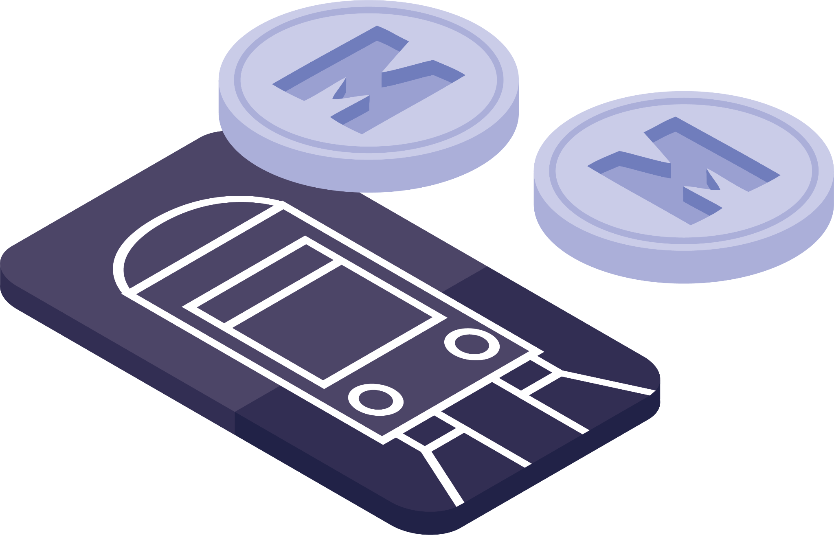
Future Scop
Artificial Intelligence (AI) Integration
Biometric Authentication
IoT-Enabled Trains
Multi-Modal Integration
Virtual Reality (VR) Ticket Booking
Enhanced Accessibility

Slide 12
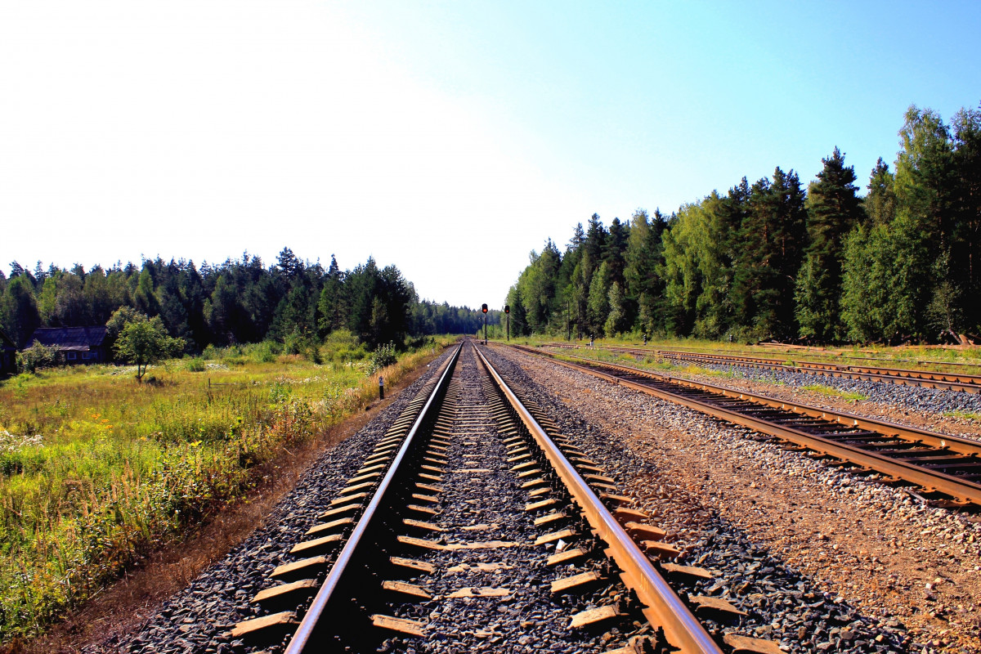
Thank You

